Slide 1

Differentiated Distribution Recovery for Neural Text Generation
Jianing Li^{1,2}, Yanyan Lan^{1,2,3}, Jiafeng Guo^{1,2}, JunXu^{1,2}, Xueqi Cheng^{1,2}
1. CAS Key Lab of Network Data Science and Technology,
Institute of Computing Technology, Chinese Academy of Sciences, Beijing, China
2. University of Chinese Academy of Sciences, Beijing, China
3. Department of Statistics, University of California, Berkeley

Slide 2



Task – Unconditional Text Generation
Machine
Generated Text
Turing Test
Human
Human-written Text

Slide 3















Task – Unconditional Text Generation
Given a text dataset, build a model $Q(x)$ for text generation.
i.i.d sampling
Training
Random sampling
$$x^{1}:$$
$$y_{1}$$
$$y_{2}$$
$$⋯$$
$$y_{T}$$
$$Q(x)$$
$P(x)$
$$x^{2}:$$
$$y_{1}$$
$$y_{2}$$
$$⋯$$
$$y_{T}$$
$$⋯⋯$$
$$x^{N}:$$
$$y_{1}$$
$$y_{2}$$
$$⋯$$
$$y_{T}$$
Real Distribution
Dataset
Model
Samples

Slide 4
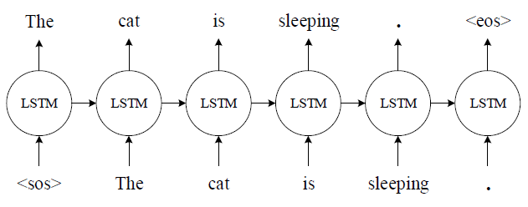
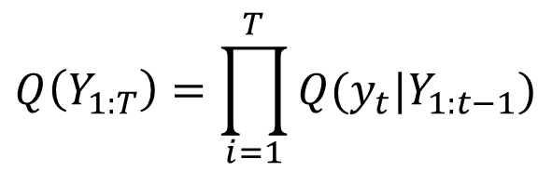

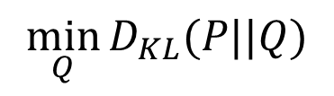

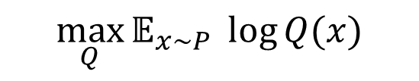
RNN-based Language Model
Most widely used method for text generation
Probability Decomposition:
$$x≔Y_{1:T}$$
$$Q\left(Y_{1:T}\right)=\prod_{i=1}^{T}{Q(y_{t}|Y_{1:t−1})}$$
Training by Maximum Likelihood Estimation (MLE)
Precise Distribution Recovery
$$\max_{Q}{𝔼_{x\sim P} \log{Q(x)}}$$
$$\min_{Q}{D_{KL}(P||Q)}$$
$$Q^{∗}=P$$

Slide 5

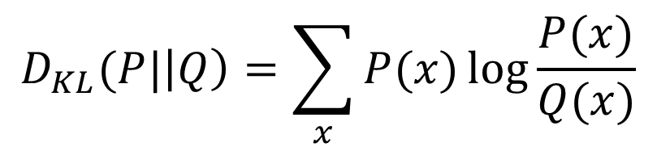

The Low-quality Problem
RNNLM achieves only 49% Turing Test pass rate on MSCOCO dataset.
MLE(Precise distribution recovery) tries to fit all training data, including those with noises and rare patterns, which is not necessary for high generation quality
$$D_{KL}(P|\left|Q\right)=\sum_{x}{P(x)\log{\frac{P(x)}{Q(x)}}}$$
$$P\left(x\right)>0,Q\left(x\right)→0$$
$$D_{KL}(P|\left|Q\right)→∞$$

Slide 6
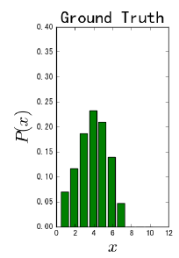
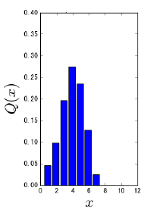
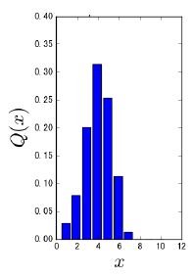
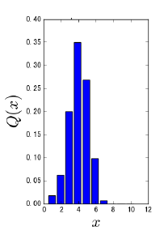
Method – Differentiated Distribution Recovery
Idea: Let the model focus more on significant patterns and neglect bad training data such as noises and rare patterns

Slide 7
Method – Differentiated Distribution Recovery
Concerns on generation diversity
Quality: Generated text should contain less grammatical and logical errors.
Diversity: Generated text should not share similar words and structures.
Primary! We do not accept samples with errors.
Secondary. Similar samples are acceptable to some extent.
The quality-diversity trade-off could be controlled

Slide 8
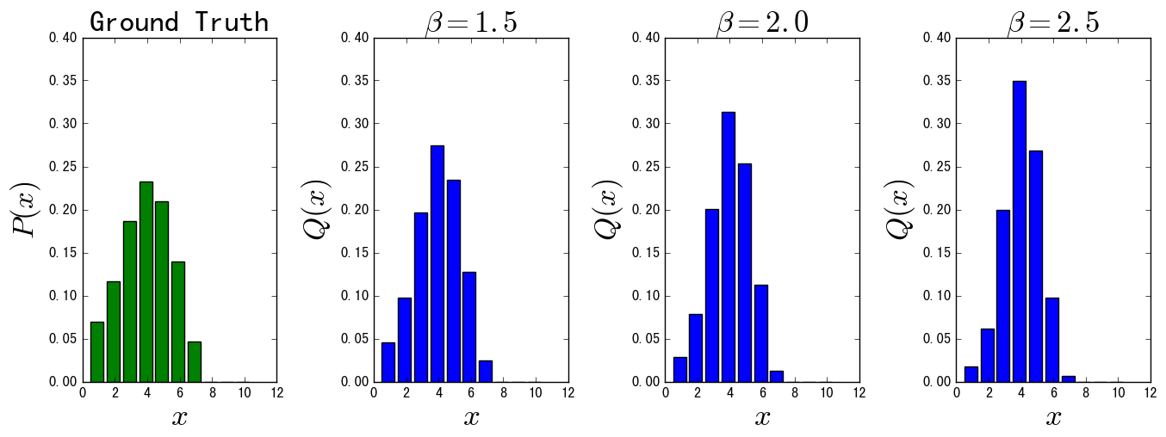
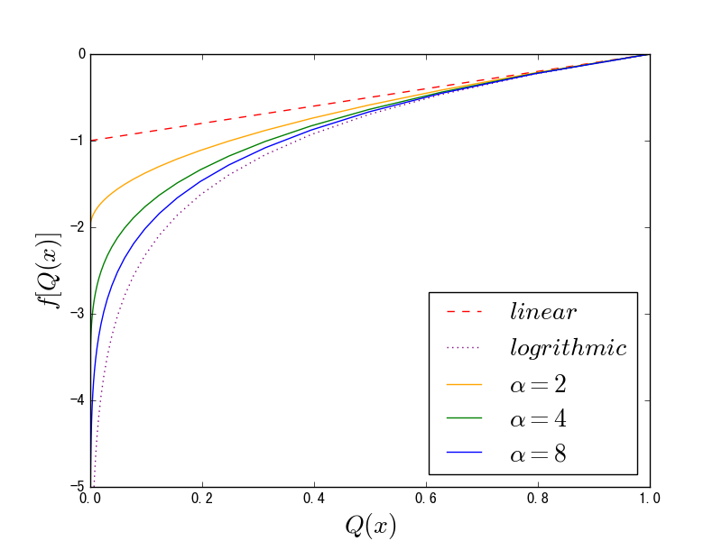
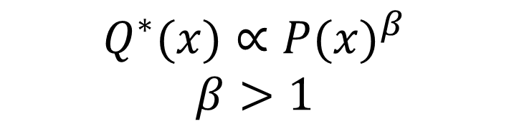

Method – Differentiated Distribution Recovery
Differentiated Distribution Recovery (DDR):
$$Q^{∗}(x)∝{P(x)}^{β}$$
$$β>1$$
Realization:
$$\max_{Q}{𝔼_{x\sim P} f[Q(x)]},$$
$$f\left(Q\left(x\right);α\right)=α∙{Q\left(x\right)}^{\frac{1}{α}}−α,$$
$$α=\frac{β}{β−1}>1$$

Slide 9
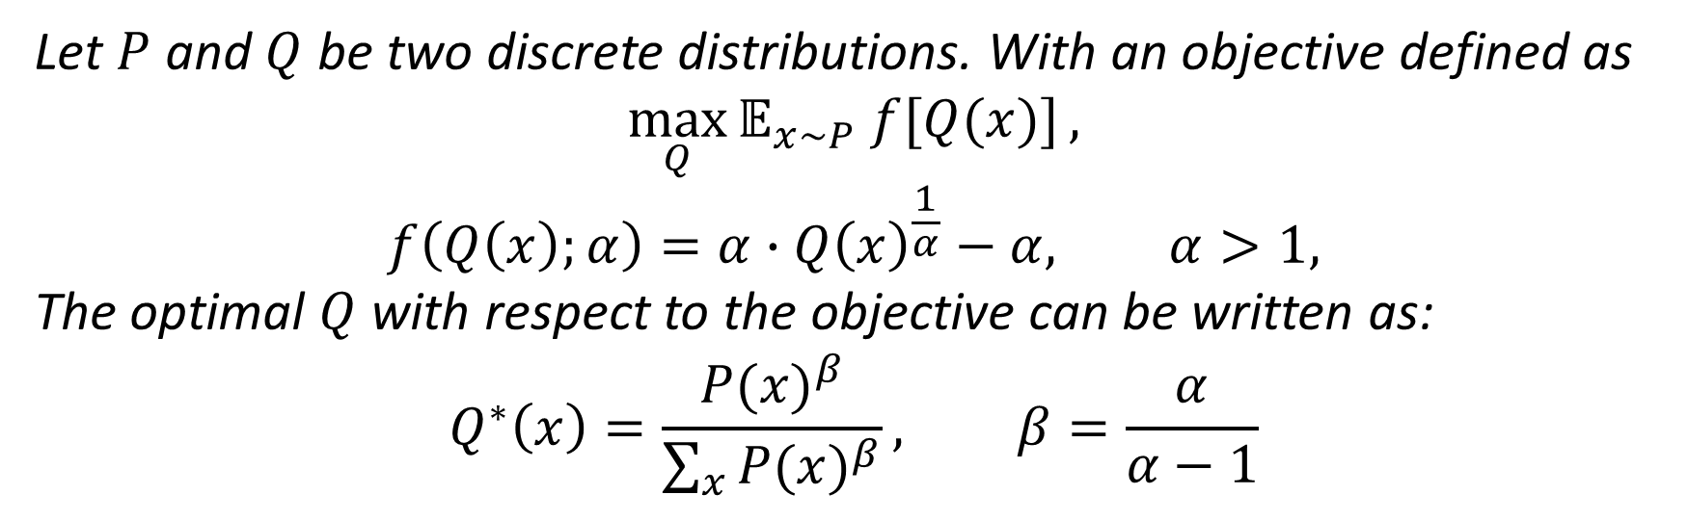
Method – Differentiated Distribution Recovery
Theorem
Let $P$ and $Q$ be two discrete distributions. With an objective defined as
$$\max_{Q}{𝔼_{x\sim P} f[Q(x)]},$$
$$f\left(Q\left(x\right);α\right)=α∙{Q\left(x\right)}^{\frac{1}{α}}−α, α>1,$$
The optimal $Q$ with respect to the objective can be written as:
$$Q^{∗}\left(x\right)=\frac{{P(x)}^{β}}{\sum_{x}{{P(x)}^{β}}}, β=\frac{α}{α−1}$$

Slide 10

Method – Implementation of DDR
Loss function
$$ℒ\left(𝒟;α\right)=−\frac{1}{N}\sum_{i=1}^{N}{α∙{Q\left(Y_{1:T}^{i}\right)}^{\frac{1}{α}}}$$
$$=−\frac{α}{N}\sum_{i=1}^{N}{\prod_{t=1}^{T}{{Q\left(y_{t}^{i}|Y_{1:t−1}^{i}\right)}^{\frac{1}{α}}}}$$
$$=−\frac{α}{N}\sum_{i=1}^{N}{exp⁡\left\{\frac{1}{α}\sum_{t=1}^{T}{\log{Q\left(y_{t}^{i}|Y_{1:t−1}^{i}\right)}}\right\}}$$
Easy to implement
No extra training overhead

Slide 11
Experiments – Settings
Datasets
Synthetic data
MSCOCO Image Caption dataset
EMNLP2017 WMT News dataset
Baselines
RNNLM
SeqGAN (Yu et al. 2017)
LeakGAN (Guo et al. 2017)
General model architecture
Softmax Output Layer
LSTM Layer
Embedding Layer

Slide 12
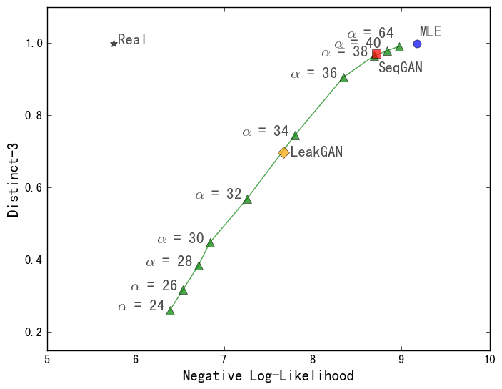
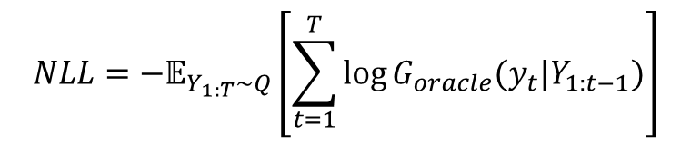
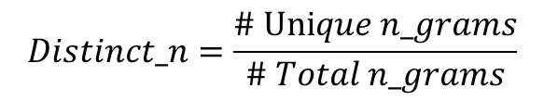
Experiments – Synthetic Data
Use an oracle model (Yu et al. 2017) to generate data.
Attributes
#Training data: 10000
Sequence length: 20
Vocabulary size: 5000
Evaluation metrics:
Higher
Diversity
$$NLL=−𝔼_{Y_{1:T}\sim Q}\left[\sum_{t=1}^{T}{\log{G_{oracle}(y_{t}|Y_{1:t−1})}}\right]$$
Higher
Quality
$$Distinct_n=\frac{\# Unique n_grams}{\# Total n_grams}$$

Slide 13
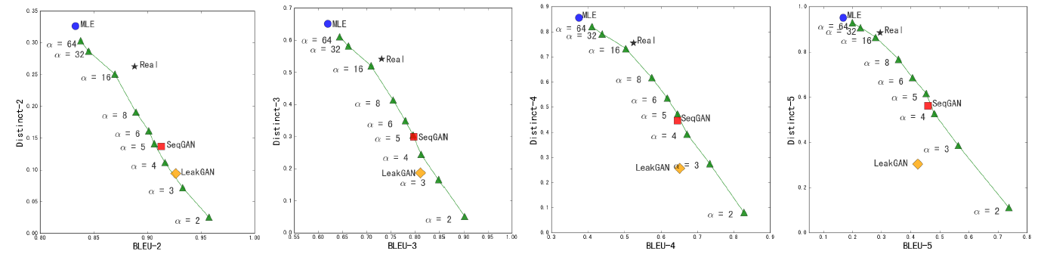
Experiments – MSCOCO Dataset
Attributes
#Training/Test data: 80000/5000
Sequence length: 32
Vocabulary size: 4840
Evaluation Metrics:
BLEU-(2-5)
Distinct-(2-5)
Higher
Diversity
Higher
Quality

Slide 14
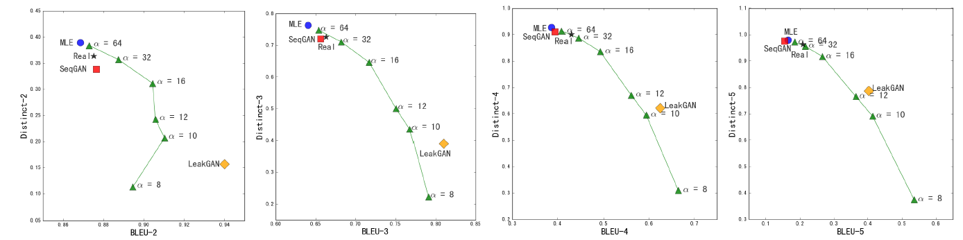
Experiments – WMT Dataset
Attributes
#Training/Test data: 200000/10000
Sequence length: 50
Vocabulary size: 6655
Evaluation Metrics:
BLEU-(2-5)
Distinct-(2-5)
Higher
Diversity
Higher
Quality

Slide 15
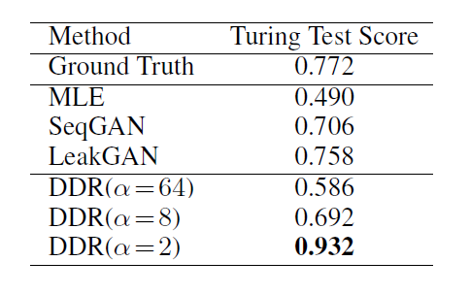
Experiments – Human Turing Test
Sample 50 sentences from each model, and mix all sentences together.
10 Ph.D students are invited to give scores individually for all samples.
A sample get +1 score if one think it is possibly written by a human, otherwise get +0 score.
Generation quality is significantly improved with DDR

Slide 16
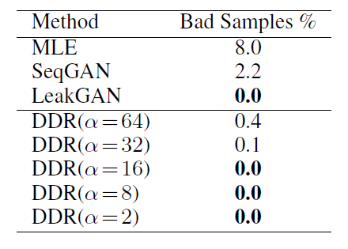
Experiments – Robustness Test
Add 10% random noises to MSCOCO dataset.
See how many bad sentences are generated by models.
A sample is regarded as bad if its BLEU-2 score is lower than 0.001
Model become more robust with DDR

Slide 17

Conclusion
The idea of neglecting bad training data is useful for higher generation quality on unconditional neural text generation tasks.
Differentiated Distribution Recovery is an effective way to neglect bad training data, which significantly promotes generation quality.

Slide 18
Thank you!
Q&A
Jianing Li
lijianing@software.ict.ac.cn

